Slide 1
Internships 2023 - 2024
School of Computer Science and Statistics
Dr. Tim Savage - Internship Program Director, SCSS
  Ms. Eimear Morhan – Internship Administrator, SCSS
    Date 11/09/2022

Slide 2

Purpose of the Internship Module
Academic​
To further develop the student’s understanding of how the design and theoretical aspects of computer science are applied to practical problems within a real-world context.
Professional​
To gain relevant work experience. Build a professional network​ and build your reputation for performance.

Slide 3
Internship Pathway & Eligibility
You must be on the Masters (MCS/MAI) track to take an Internship
Internship is mandatory for MCS students
Internship is optional for MAI students
Eligibility
Students must have a minimum grade of II.1 at the first sitting of the Junior Sophister examinations

Slide 4
Is the Masters worth doing?
MSc Computing is best Masters degree to improve job prospects​
Paid internships​
    Work with a good quality employer​
    Build a long-term career network​
How does an MSc / Internship impact on your career​
  Immediately more employable​
  Over 70% students surveyed said they had been offered or intended to return to company on graduation​
  More interesting / challenging work​
  Faster promotion

Slide 5
The Big Picture (1)
Available to MCS and MAI students.​
You must actively sign up for the Masters.​
This is a great opportunity for you — make sure you maximise it.​
You represent us — Trinity College Dublin, SCSS & Engineering.​
You become an employee of your host for the duration of your internship.​
At the same time, you will be working to pursue your academic goals.​
Internship Window:​
  5 - 8 Months, January 2023 – July/August 2023

Slide 6
The Big Picture (2)
In Company​
  You have a company supervisor or mentor.​
  You do interesting & challenging work.​
  You have an academic liaison — a member of staff in SCSS.​
Academically the Internship is 30 ECTS (50% of the 4th year result)​
  40% - Report 1: Goals, Reflective Journal, Project Management Report​
  10% In-company Presentation ​
  50% Report 2: Design and Development Report

Slide 7

Representing TCD
The internship is an integral part of your education at TCD.​
Our reputation is part of the reason you obtained the internship.​
Please make every effort to maintain and enhance that reputation for yourself and future interns.​
Make every effort to be a useful and cooperative professional .​
Bear in mind that the patterns of work and behaviour are very different between College and the workplace – example, time keeping!​
Remember you are TCD “ambassadors”.

Slide 8
Learning Outcomes
Contribute to the design and development of systems at the forefront of computer science and critically evaluate their performance​
Apply theoretical knowledge in an industrial or research laboratory setting to solve real world problems​
Practice and further develop skills in communication, management and teamwork​
Practice and further develop skills in time management and reporting within an industrial or research laboratory setting​
Contribute to an ethical and professional work culture

Slide 9
Lecture Content
CVs
Interviews
Assessment
Reflection
Well being
Preparation
Updates

Slide 10
The Process
You need to secure an internship January 2024, minimum of 5 months.
Students apply directly to the companies they are interested in taking up a placement with
Each company uses their Normal HR process to hire Interns​
Never accept an offer if you don’t intend to take the position​
Offers need to be complete by 30th November 2023 – Internship Agreement
Companies with approved internship opportunities are added to the SCSS Internship Website.

Slide 11
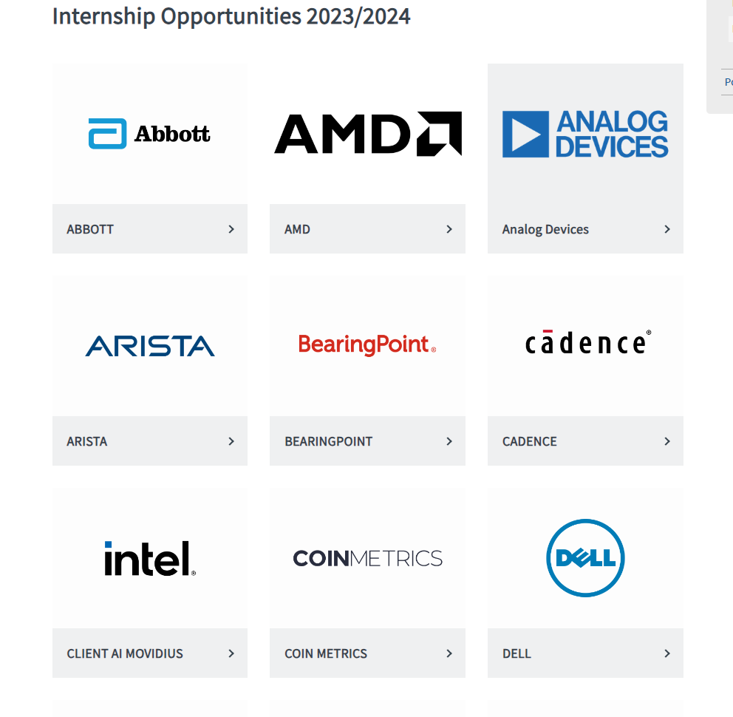
SCSS Internship Website
https://www.tcd.ie/scss/courses/undergraduate/internships-for-students/current-opportunities/
Your company not listed - get in touch!
Students can start applying as soon as they are ready.
Please don't apply for internships which you will not take.
Once you've accepted an offer never rescind!
Internship Handbook

Slide 12



Internship Sessions
Monday, 1pm – 2pm, LB01
Sessions take place during Semester 1
CV, cover letters, making applications
Internship Speed Connect prep.
Company updates
Assessment details
Company visits
Practicalities – student agreements etc
'What to expect' guest speaker
Looking after yourself on placement

Slide 13


Internship Speed Connect
Monday 2nd October , 1.30 - 5.00pm
In-person event
Opportunity to meet with multiple companies in a fun, fast-paced format.
Prior to event students will book into slots with up to 12 companies.
Networking opportunities during break.
Attendance is mandatory.

Slide 14
What our 2023 interns have to say:
Companies who hosted in 2023:
Arista | Intel | Shutterstock | BearingPoint
Edgescan | HubSpot | Rapid7 | CoinMetrics
Ericsson | Lexis Nexis | SIG (Susquehanna International Group) | Finbourne
Fathom | Mastercard | Workday | Amazon
Fresco | Murex | Unity | Microsoft
General Motors | Propylon | Xelda | Millennium
Guidewire | Travelport | Adapt | PwC

Slide 15
What our 2023 interns have to say:
1. Would you recommend your host company to another student?
97% Yes
2. Have you been offered a job with or do you intend to return to your internship company after graduation??
71% Yes? after on?

Slide 16
Practicalities
Blackboard
Updates will be made via Announcements on Blackboard
Slides and resources
Internship Tri-Party Agreement
Student handbook 2023-2024
Practical details on making applications
Assessment Guidelines
Submission details
Your Internship is not confirmed until Internship Agreement is complete.
It is your responsibility to return this to us signed by your company.

Slide 17
Next Steps
Month | Activity
September | Do your company research Attend CV clinic Attend Speed Connect
October | Finalise your applications Interviews
November | Accept offer Return signed Internship Agreement
January (early) | Start internship

Slide 18
Keep in touch!
Ms. Eimear Morhan
Internships Administrator
Internships@scss.tcd.ie
Dr. Tim Savage
Internship Programme Director
Internships@scss.tcd.ie
The internships email will reach both of us.
Do not hesitate to get in touch, if you have any questions or concerns.

Slide 19
Best of luck!

